Slide 1
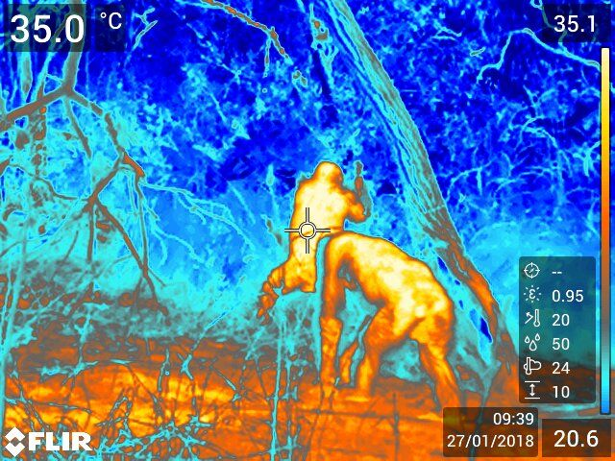
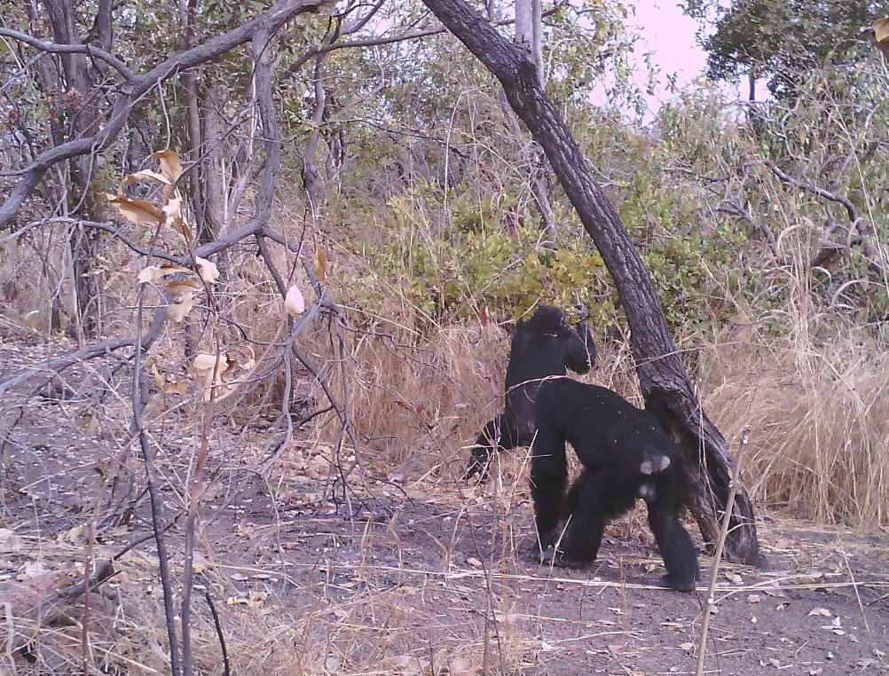
Thermo-imaging bipedalism on the savanna: Chimpanzee locomotion at Fongoli, Senegal and implications for the evolution of hominin bipedalism
Nicole wackerly
Notes:
So I’m going to be introducing you all today to some of my current research on Savanna chimpanzees using a nifty thermo-imaging camera
Fongoli is a savanna mosaic habitat, so it’s comprised of patches of woodland, grassland, and some denser vegetation, which provides nice variation for this project
And I’ll be relating this all back to the evolution of bipedalism in the hominin lineage

Slide 2
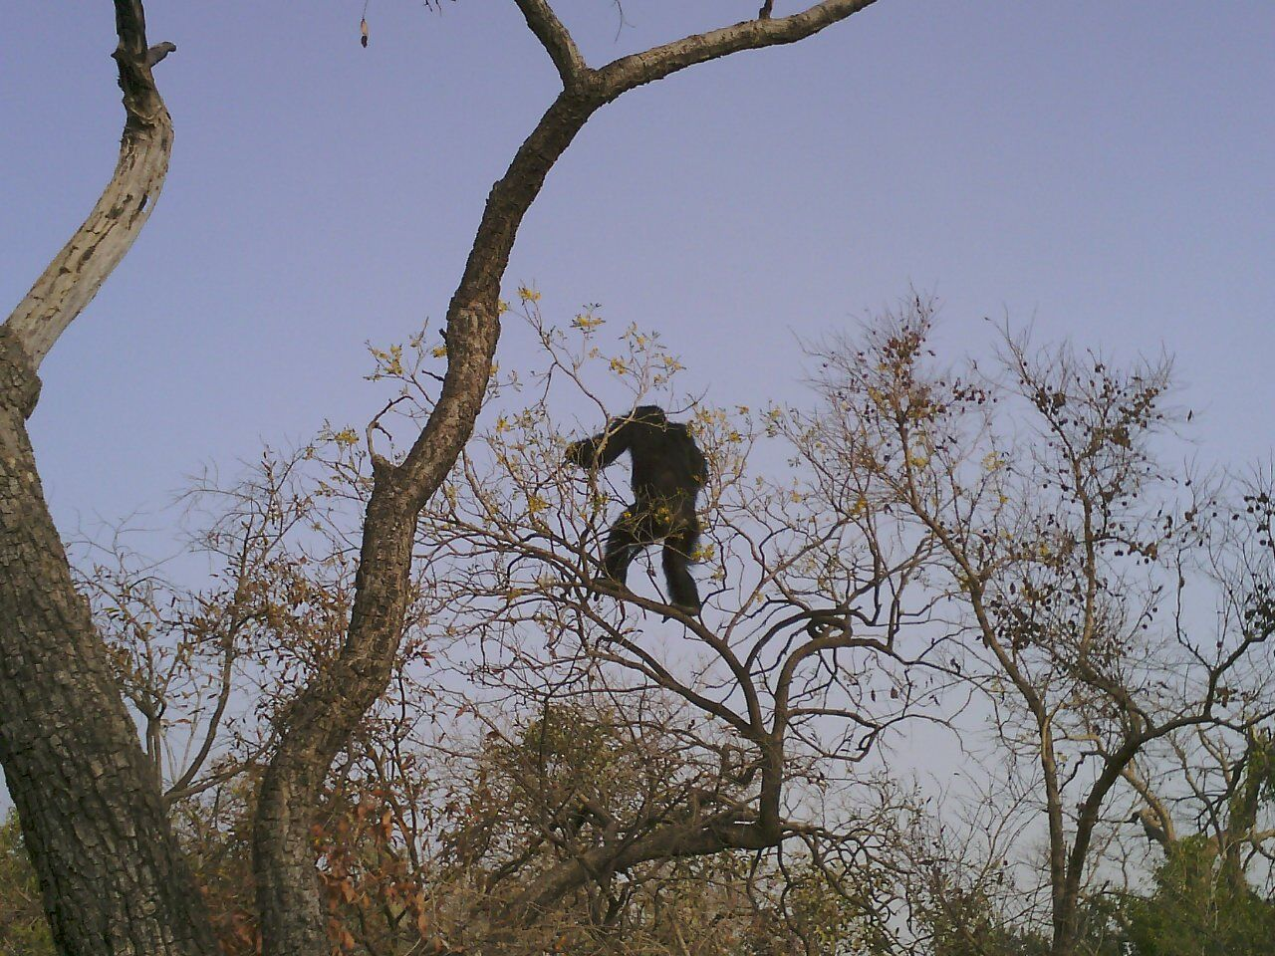
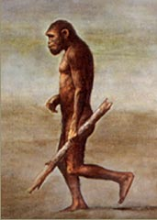
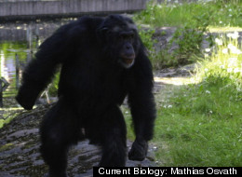
Why are humans bipedal?
photo credit: Michel Sadiakho
revistadehistoria.es
Notes:
So before jumping into things, I feel it’s necessary to provide some background/context for this research, which focuses on this main question of: What are Humans Bipedal/Why do we walk on two legs
So why did bipedalism evolve? Well, that is a question under much contention in the world of anthropology. There are many hypotheses surrounding this question, not all necessarily mutually exclusive btw, such as:
a solution to more efficient feed and foraging in the trees or on the ground
Efficient load carrying, whether for carrying tools or food
as a means of predator defense or as a threat display
But the avenue I’ll be focused on is looking at bipedalism as a means of thermoregulation

Slide 3
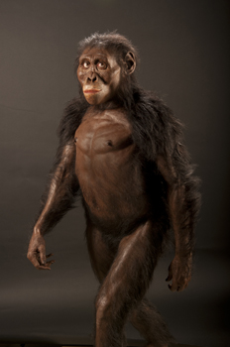
Bipedal evolution and thermoregulation
Shift in habitat from closed canopy to a more open, woody-savanna environment
Introduced new hardships
Bipedalism:
Reduces surface area exposed to direct sunlight,
Increases exposure to airflow by raising body surfaces above the ground
Favored to overcome the challenges of a hot, dry and open environment
www.cmnh.org
Notes:
So bipedalism as a means of thermoregulation
Dr. Peter Wheeler is the main proponent of this idea.
Around the time we think bipedalism evolved, we see a shift in habitat from that of a closed canopy to a more open-woody savanna, which introduced new hardships, so Wheeler proposes that adaptations lessening heat stress or enhancing heat dissipation would have faced strong selective pressures.
Bipedalism raises the torso from the ground & when doing so reduces the surface-area-to-volume ratio exposed to direct sunlight.
It also increases exposure to airflow when doing so
(Especially because primates lack of an efficient selective cooling mechanism in primates, yet a need to protect their big brains)

Slide 4
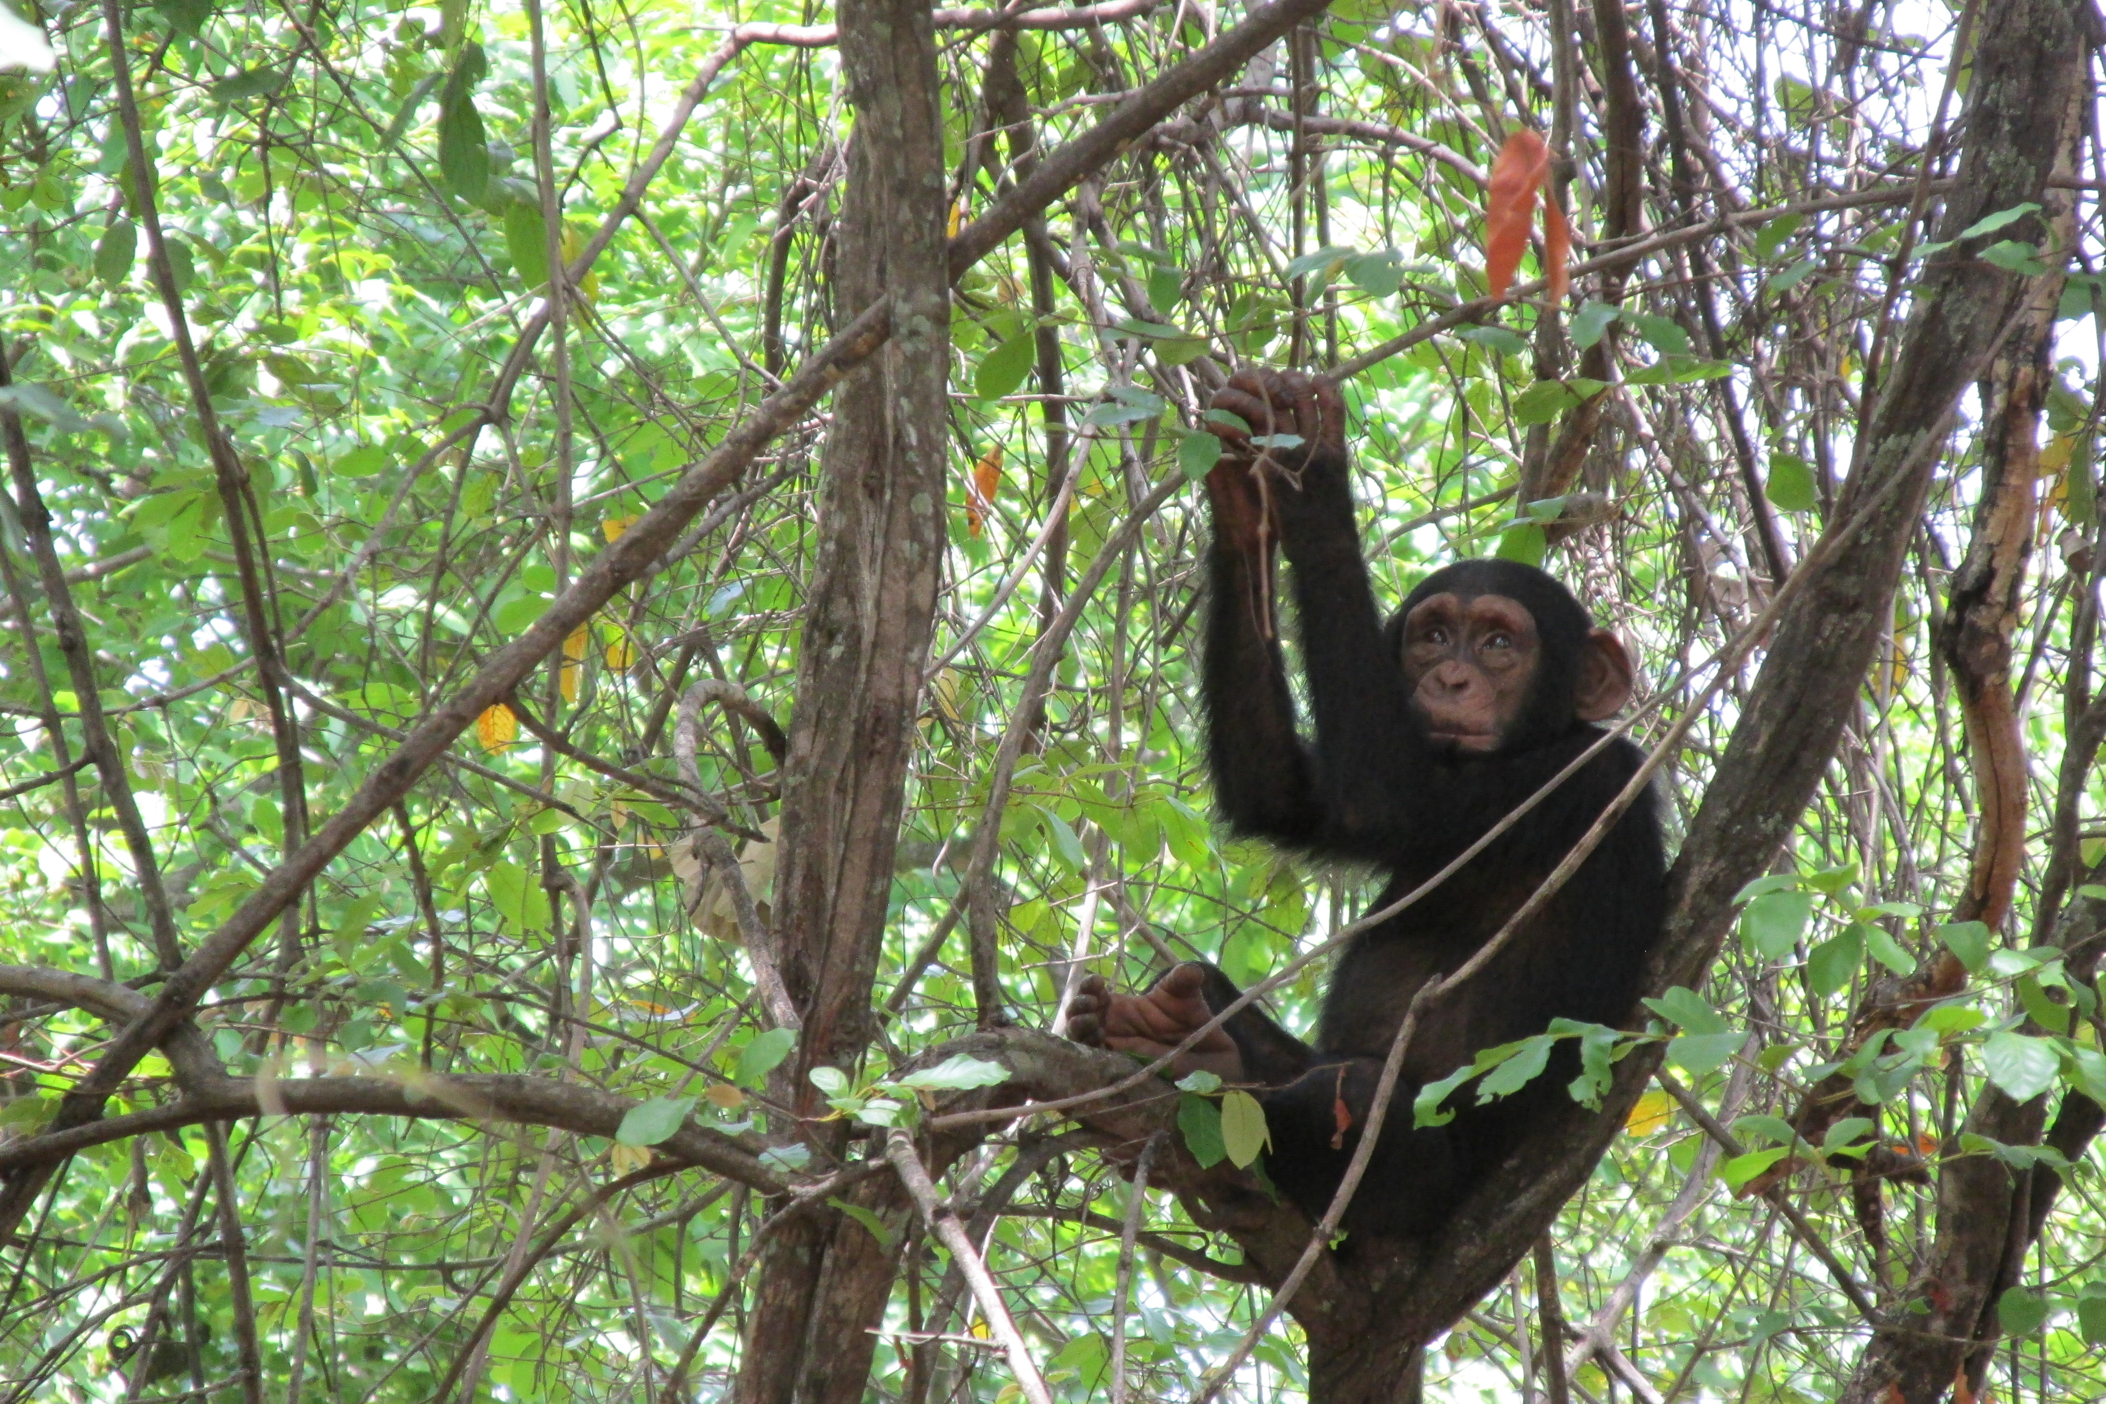
What does this have to do with chimps??
Savanna chimpanzees make good referential models:
Close evolutionary relationship to humans (homology)
Similarities in habitat to early hominins (analogy)
© Nicole Wackerly
Notes:
So using savanna chimpanzees, I intend to indirectly test the hypotheses from these models looking at bipedalism as a means of thermoregulation
Chimpanzees are our closest living relatives
But further, savanna chimpanzees live in an environment similar to the one in which we expect bipedalism evolved
So they are valuable referential models in answering these questions
So when thinking of behavioral thermoregulation in such a hot climate, certain things may come to mind.
Do they rest more? Are they seeking shade? How does this heat stress impact their day-to-day activities?

Slide 5
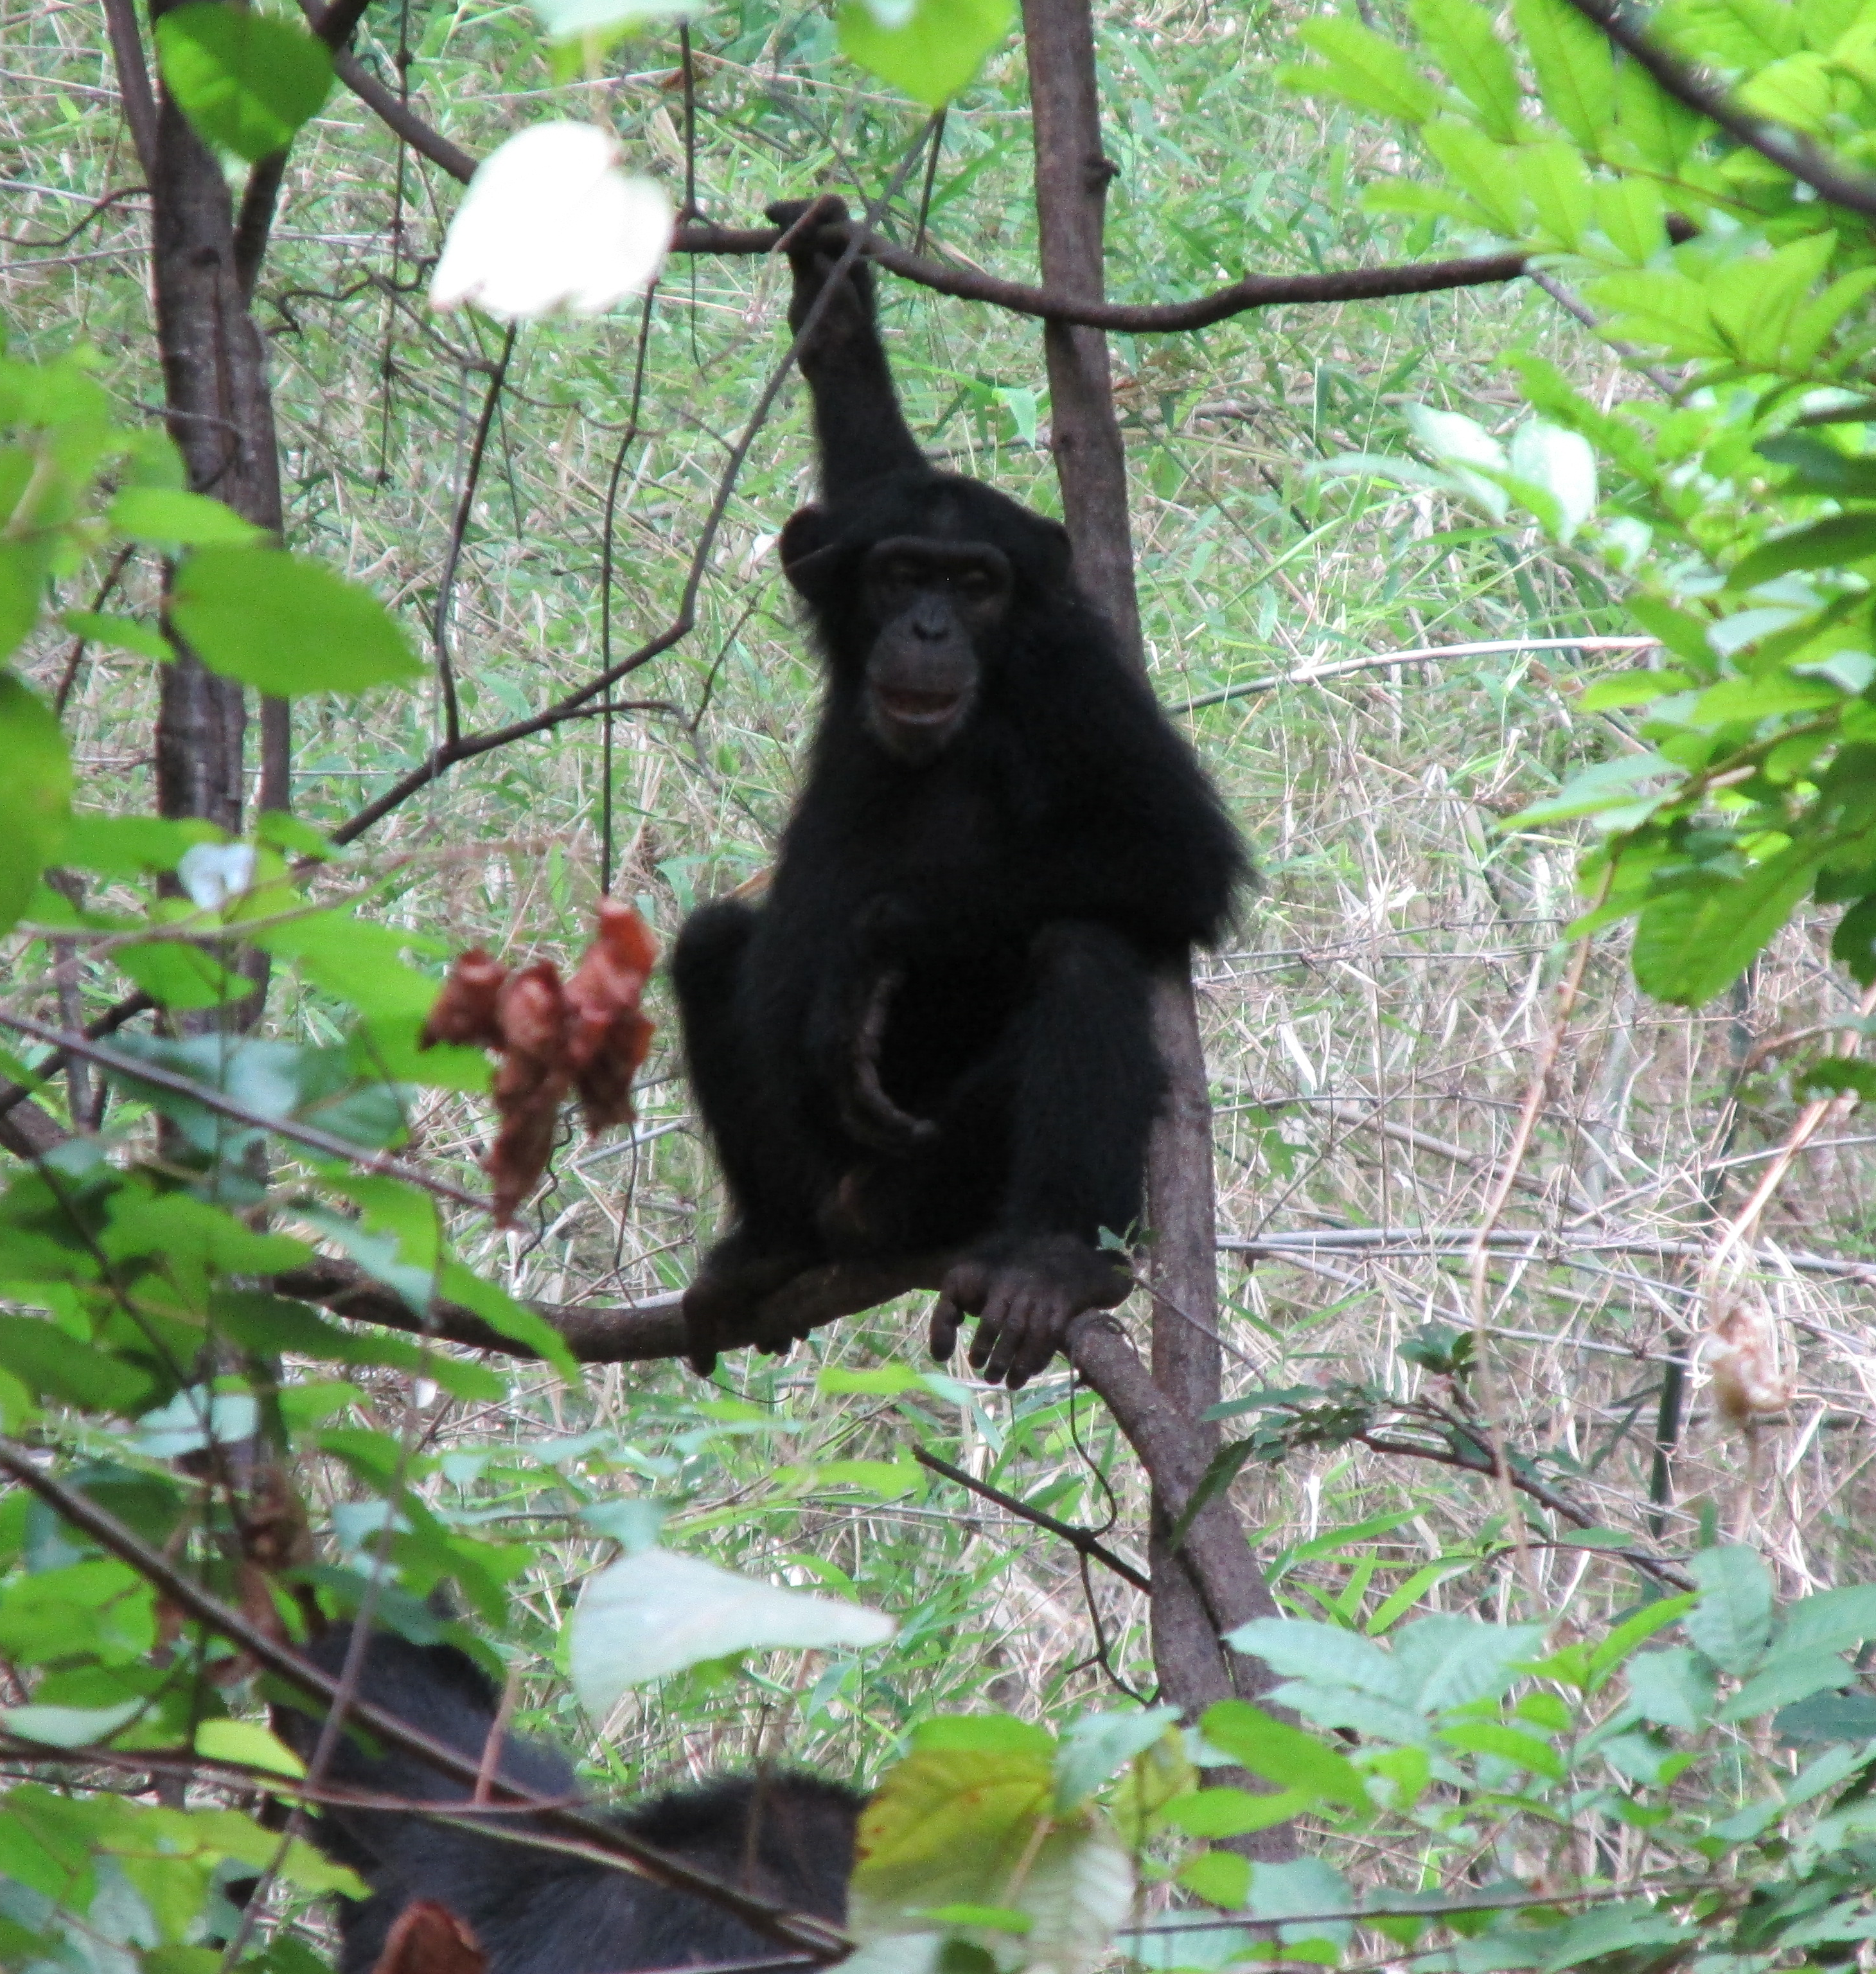
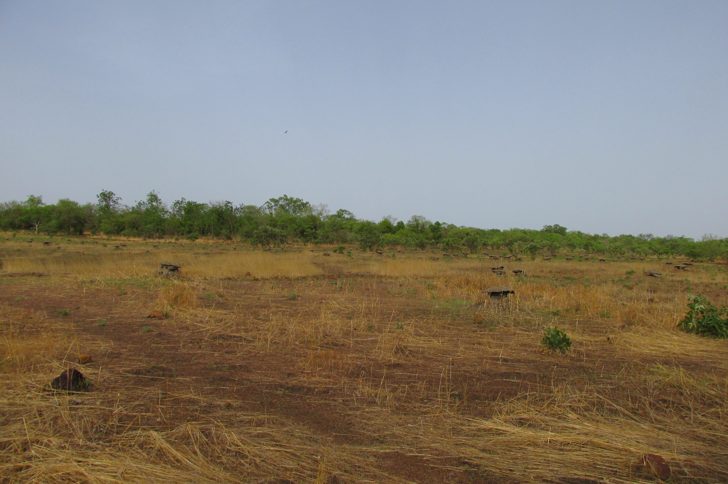
What Am I looking for?
Do open habitats exert significant thermal stresses on apes at Fongoli?
Do different postural and locomotor behaviors vary in their relative exposure to heat stress?
Juvenile male Fongoli chimpanzee: Cy; photo credit: N.W.
Notes:
One means of testing these questions of bipedalism and thermoregulation is by looking at chimp positional behaviors, that is their postural and locomotor behaviors, while using this thermo-imaging camera.
That way I can observe how positional behavior impacts body temperature
H₁: Chimpanzee body temperature will vary with differing postural and locomotor behaviors
(using surface temp as a proxy for body temp, as a previous primate study on howler monkeys showed this can be reliably done using this type of camera)
- Expected to differ in exposure to UV radiation, thereby altering the experienced thermal load
- Bipedal posture and locomotion: predicted to be associated with a lower body temperature when compared to quadrupedal positions
How did I do this?
I also want to examine how the different aspects of their habitat relate to their body temperatures
Behavior within an open environment increases chimpanzee exposure to the sun; but for now I am focused on this first question

Slide 6
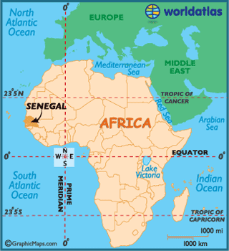
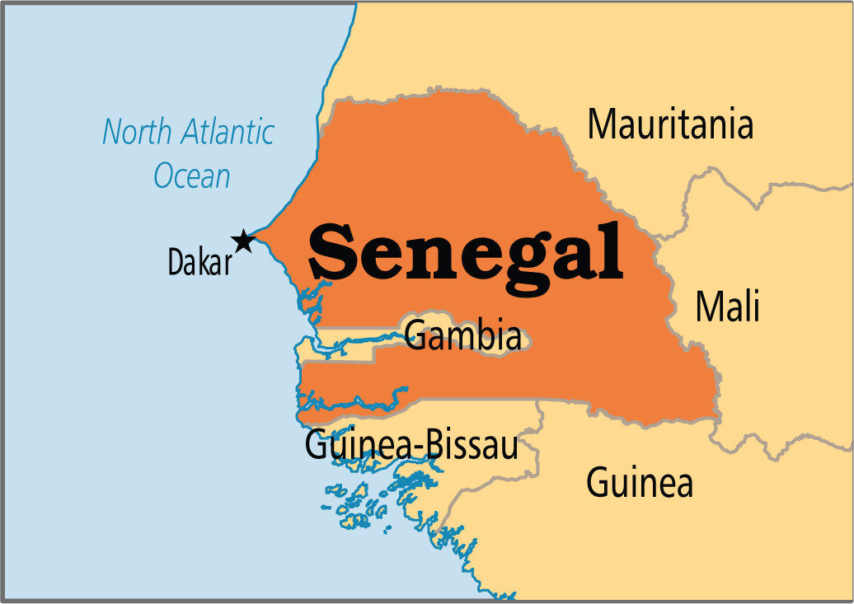
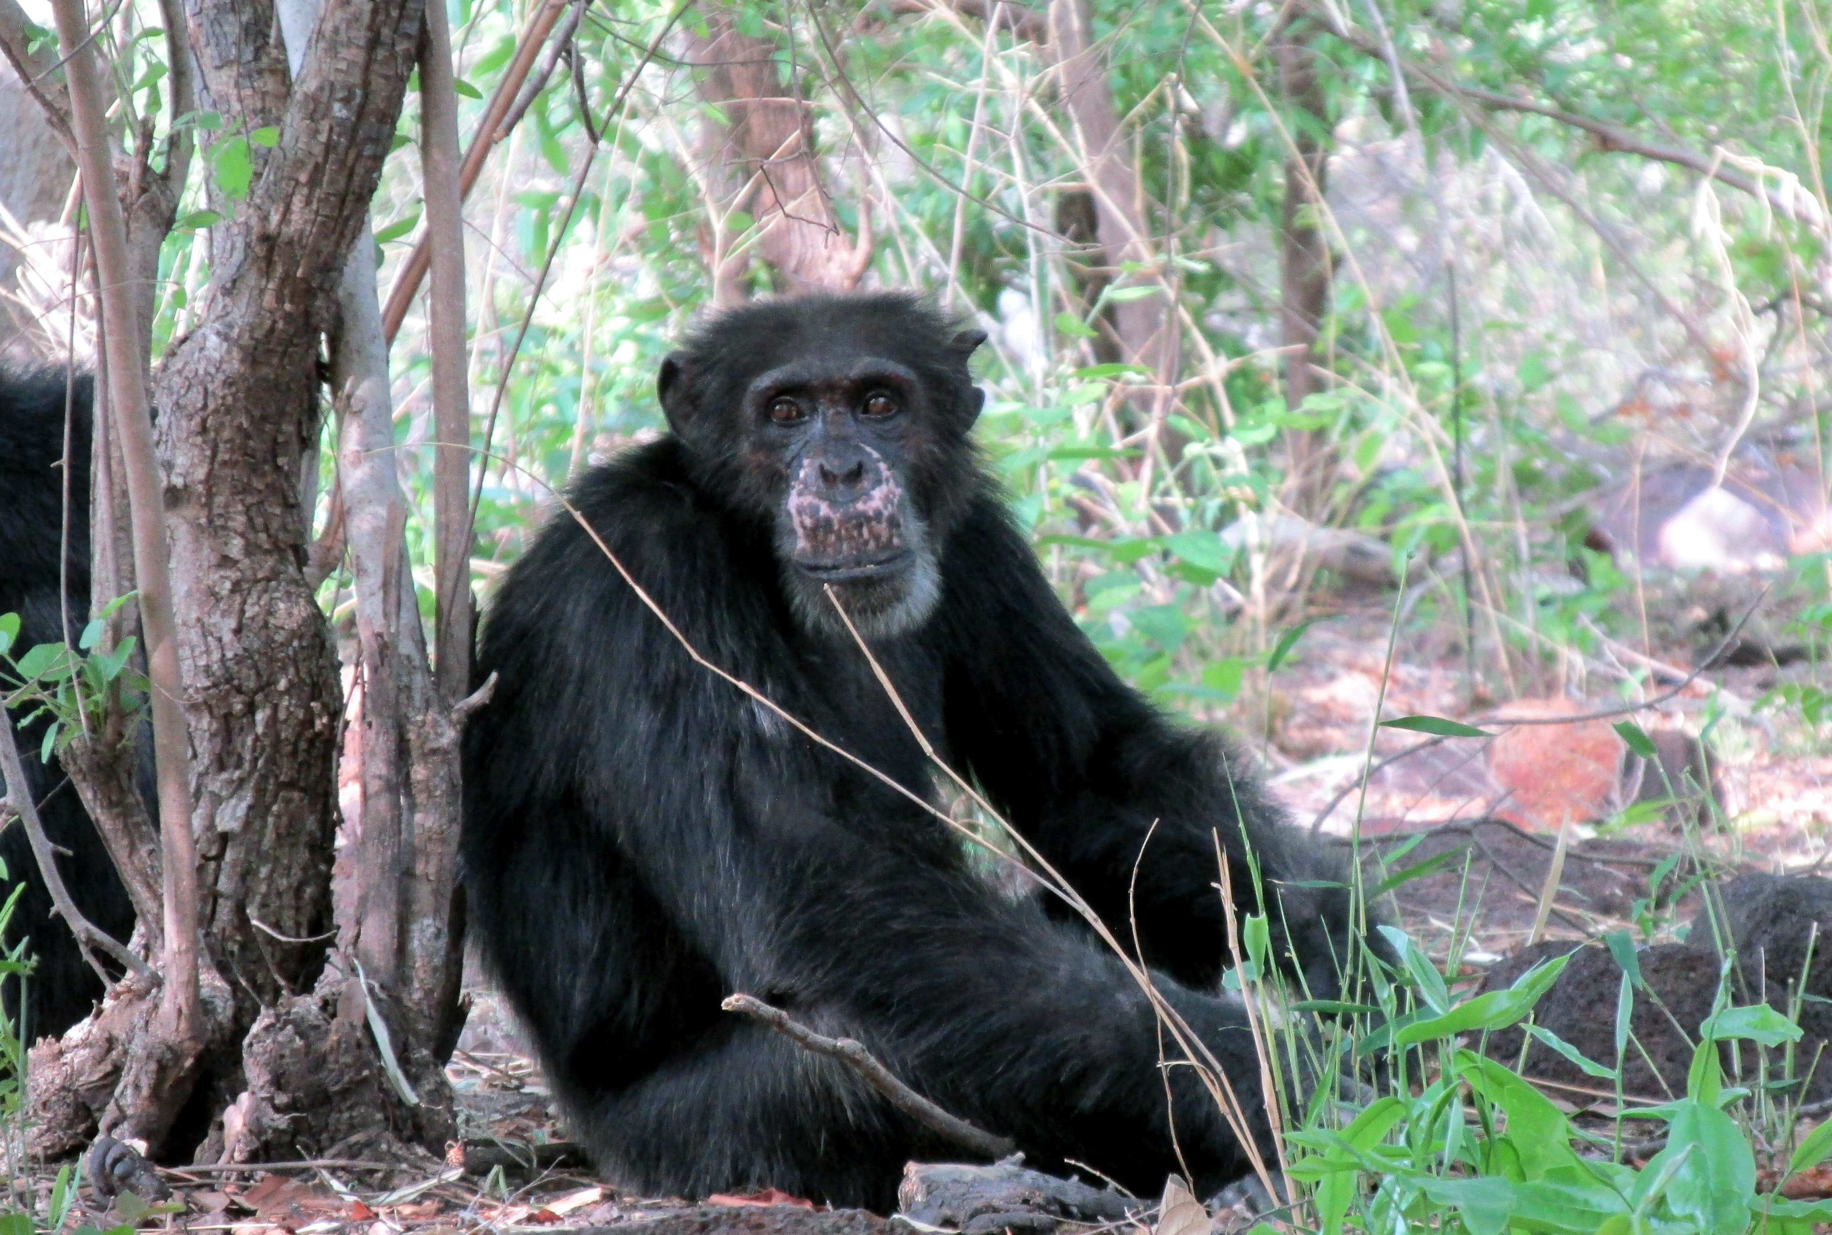
Methods – Study site & subjects
Fongoli field site in southeastern Senegal
Mosaic of grassland, woodland, gallery forest, bamboo woodland and ecotone forest habitats
Focal subjects: adult male chimpanzees (Pan troglodytes verus)
n=12
Well-habituated (since 2005)
Followed from night nest to night nest, with behavioral data collected at rough 5-minute intervals using a thermo-imaging camera
www.worldatlas.com
www.operationworld.org
Adult male Fongoli chimpanzee: Bandit; photo credit: N.W.
Notes:
Country in West Africa; May to beginning of August, 2018
Females aren’t focal follows bc we don’t want to over-habituate them, as they are targets of the pet-trade for their infants. The risk is slight, but not trivial bc this has happened at this site in the past.
So I’d pic a focal male, follow him all day and take data every 5-minutes, though bc of camera delays, it was a rough 5-min schedule. Some behaviors were captured opportunistically if they occurred less frequently to help round out my sample

Slide 7
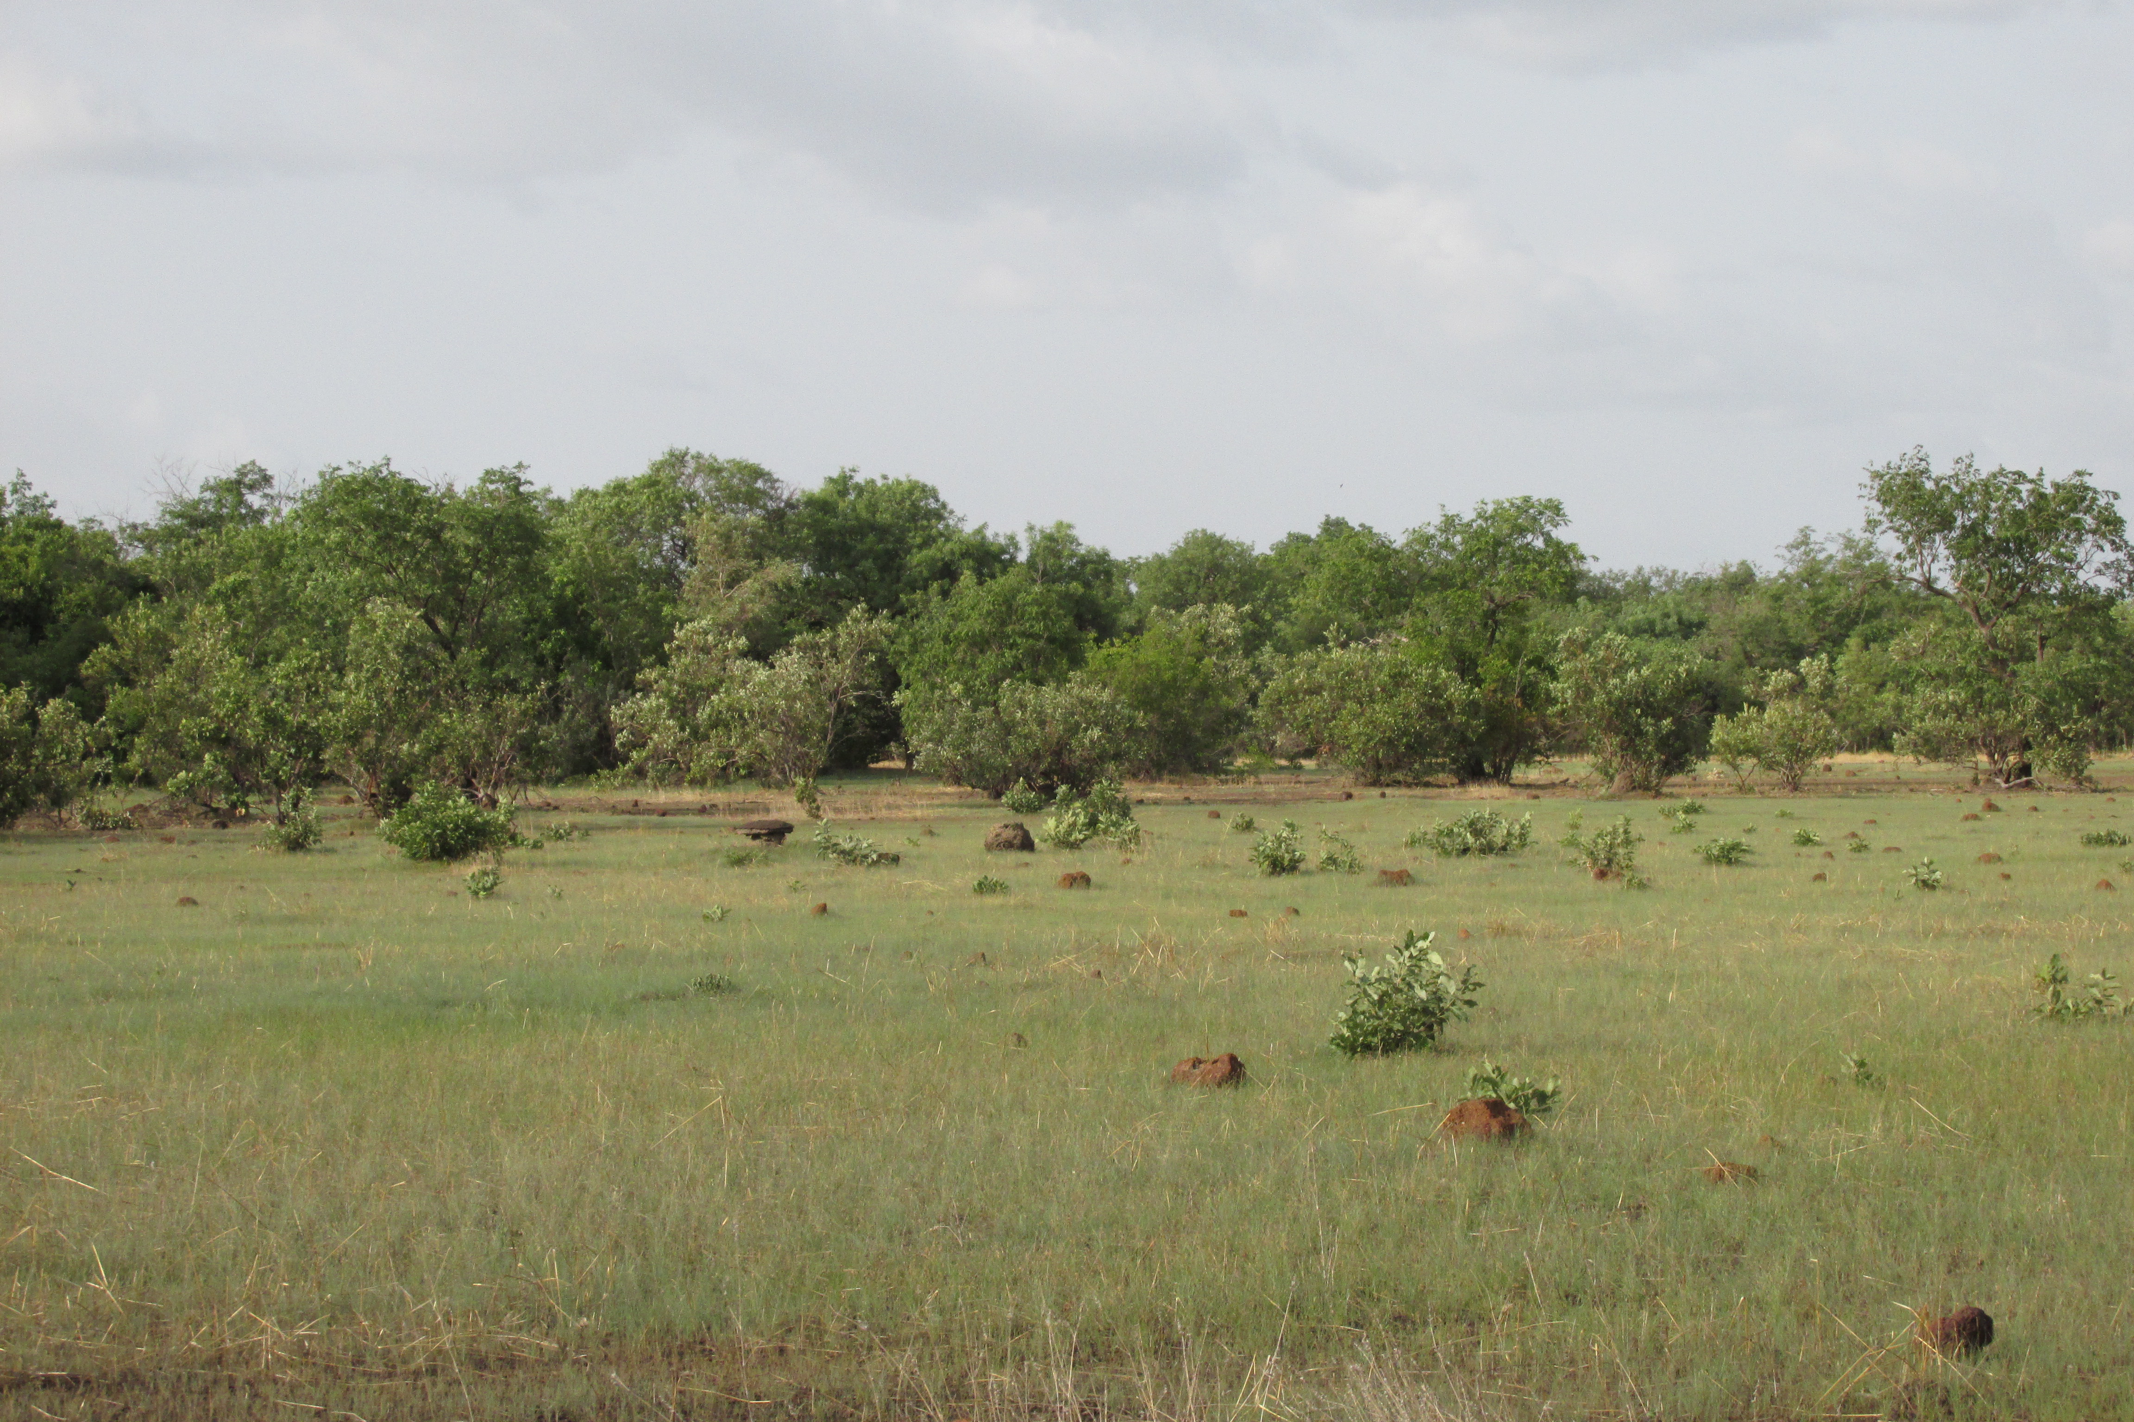
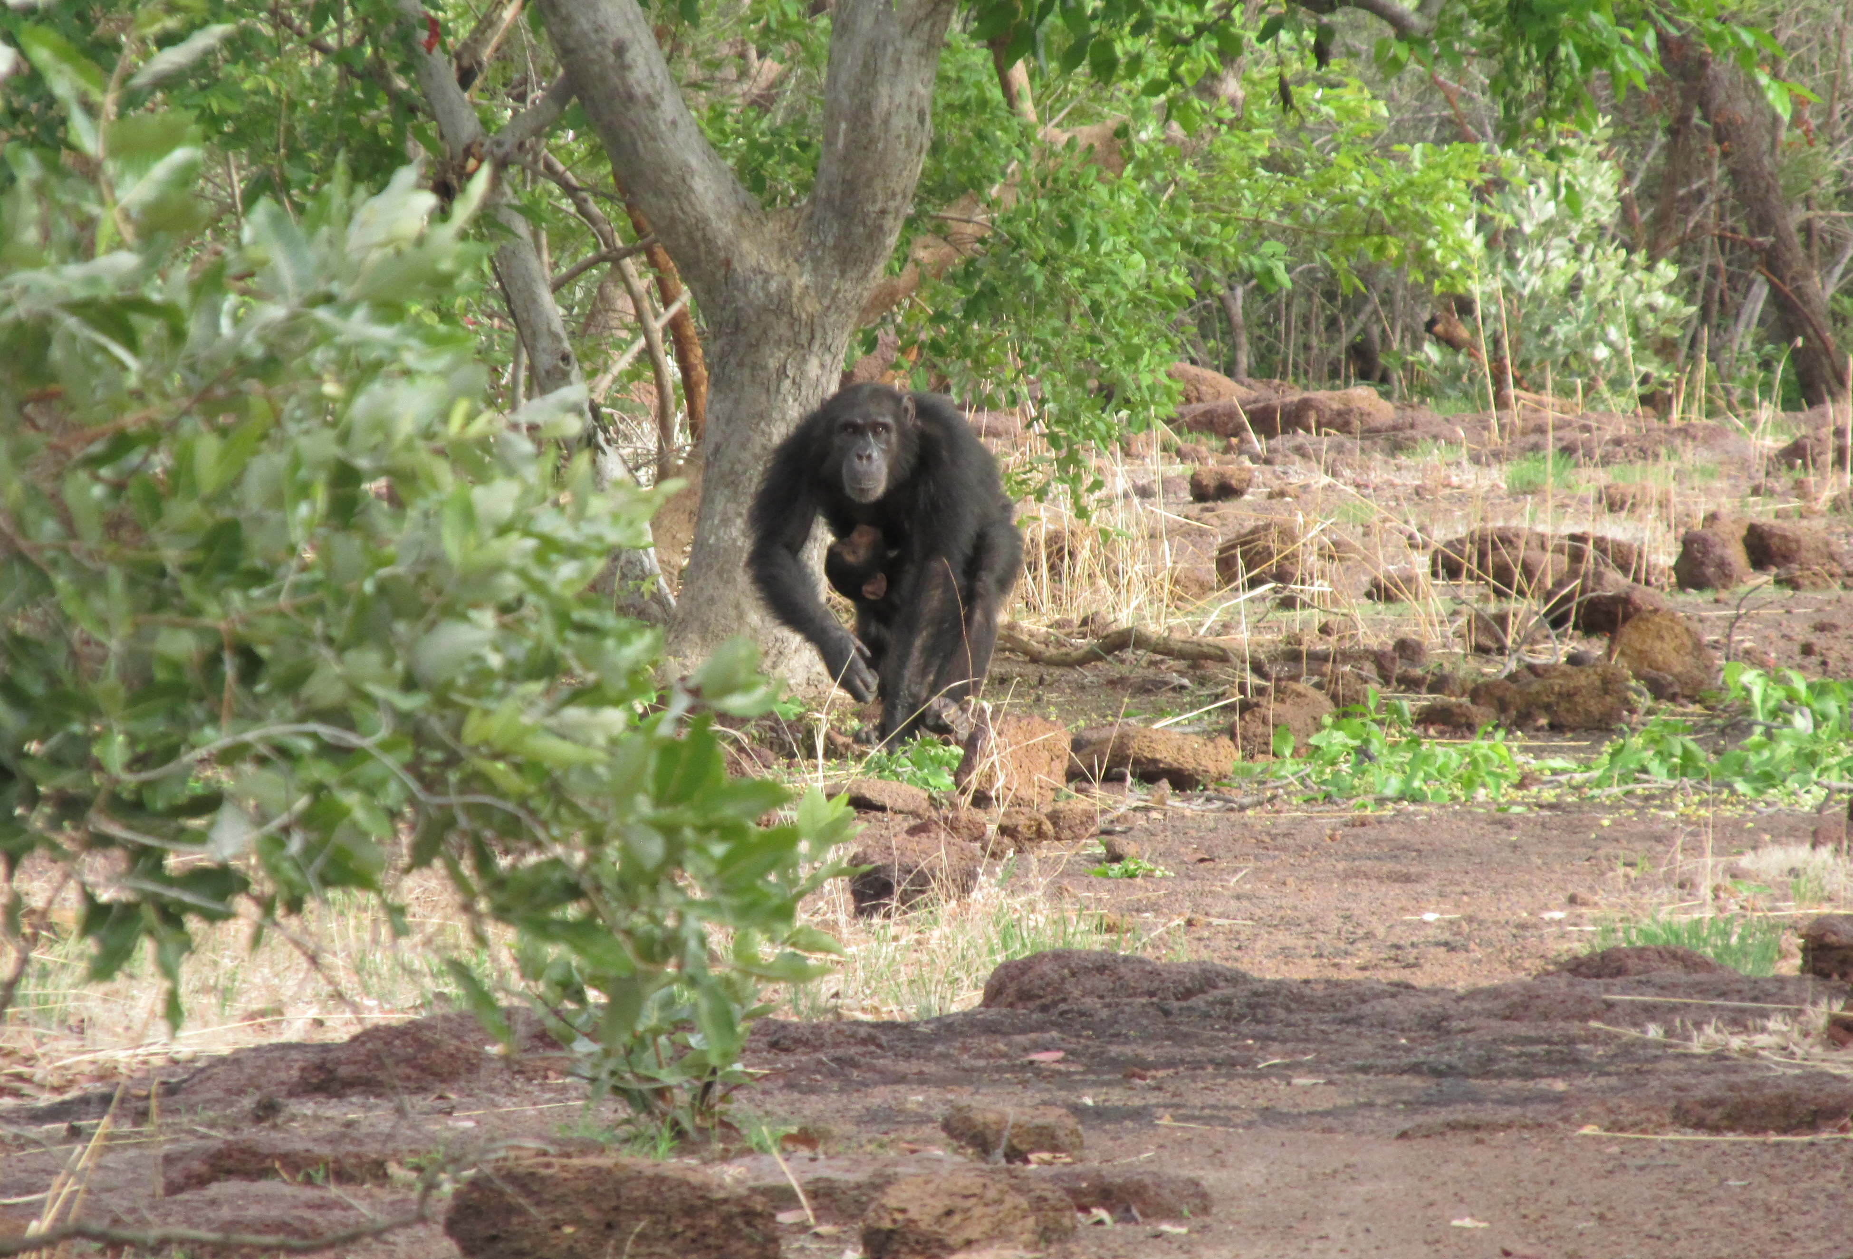
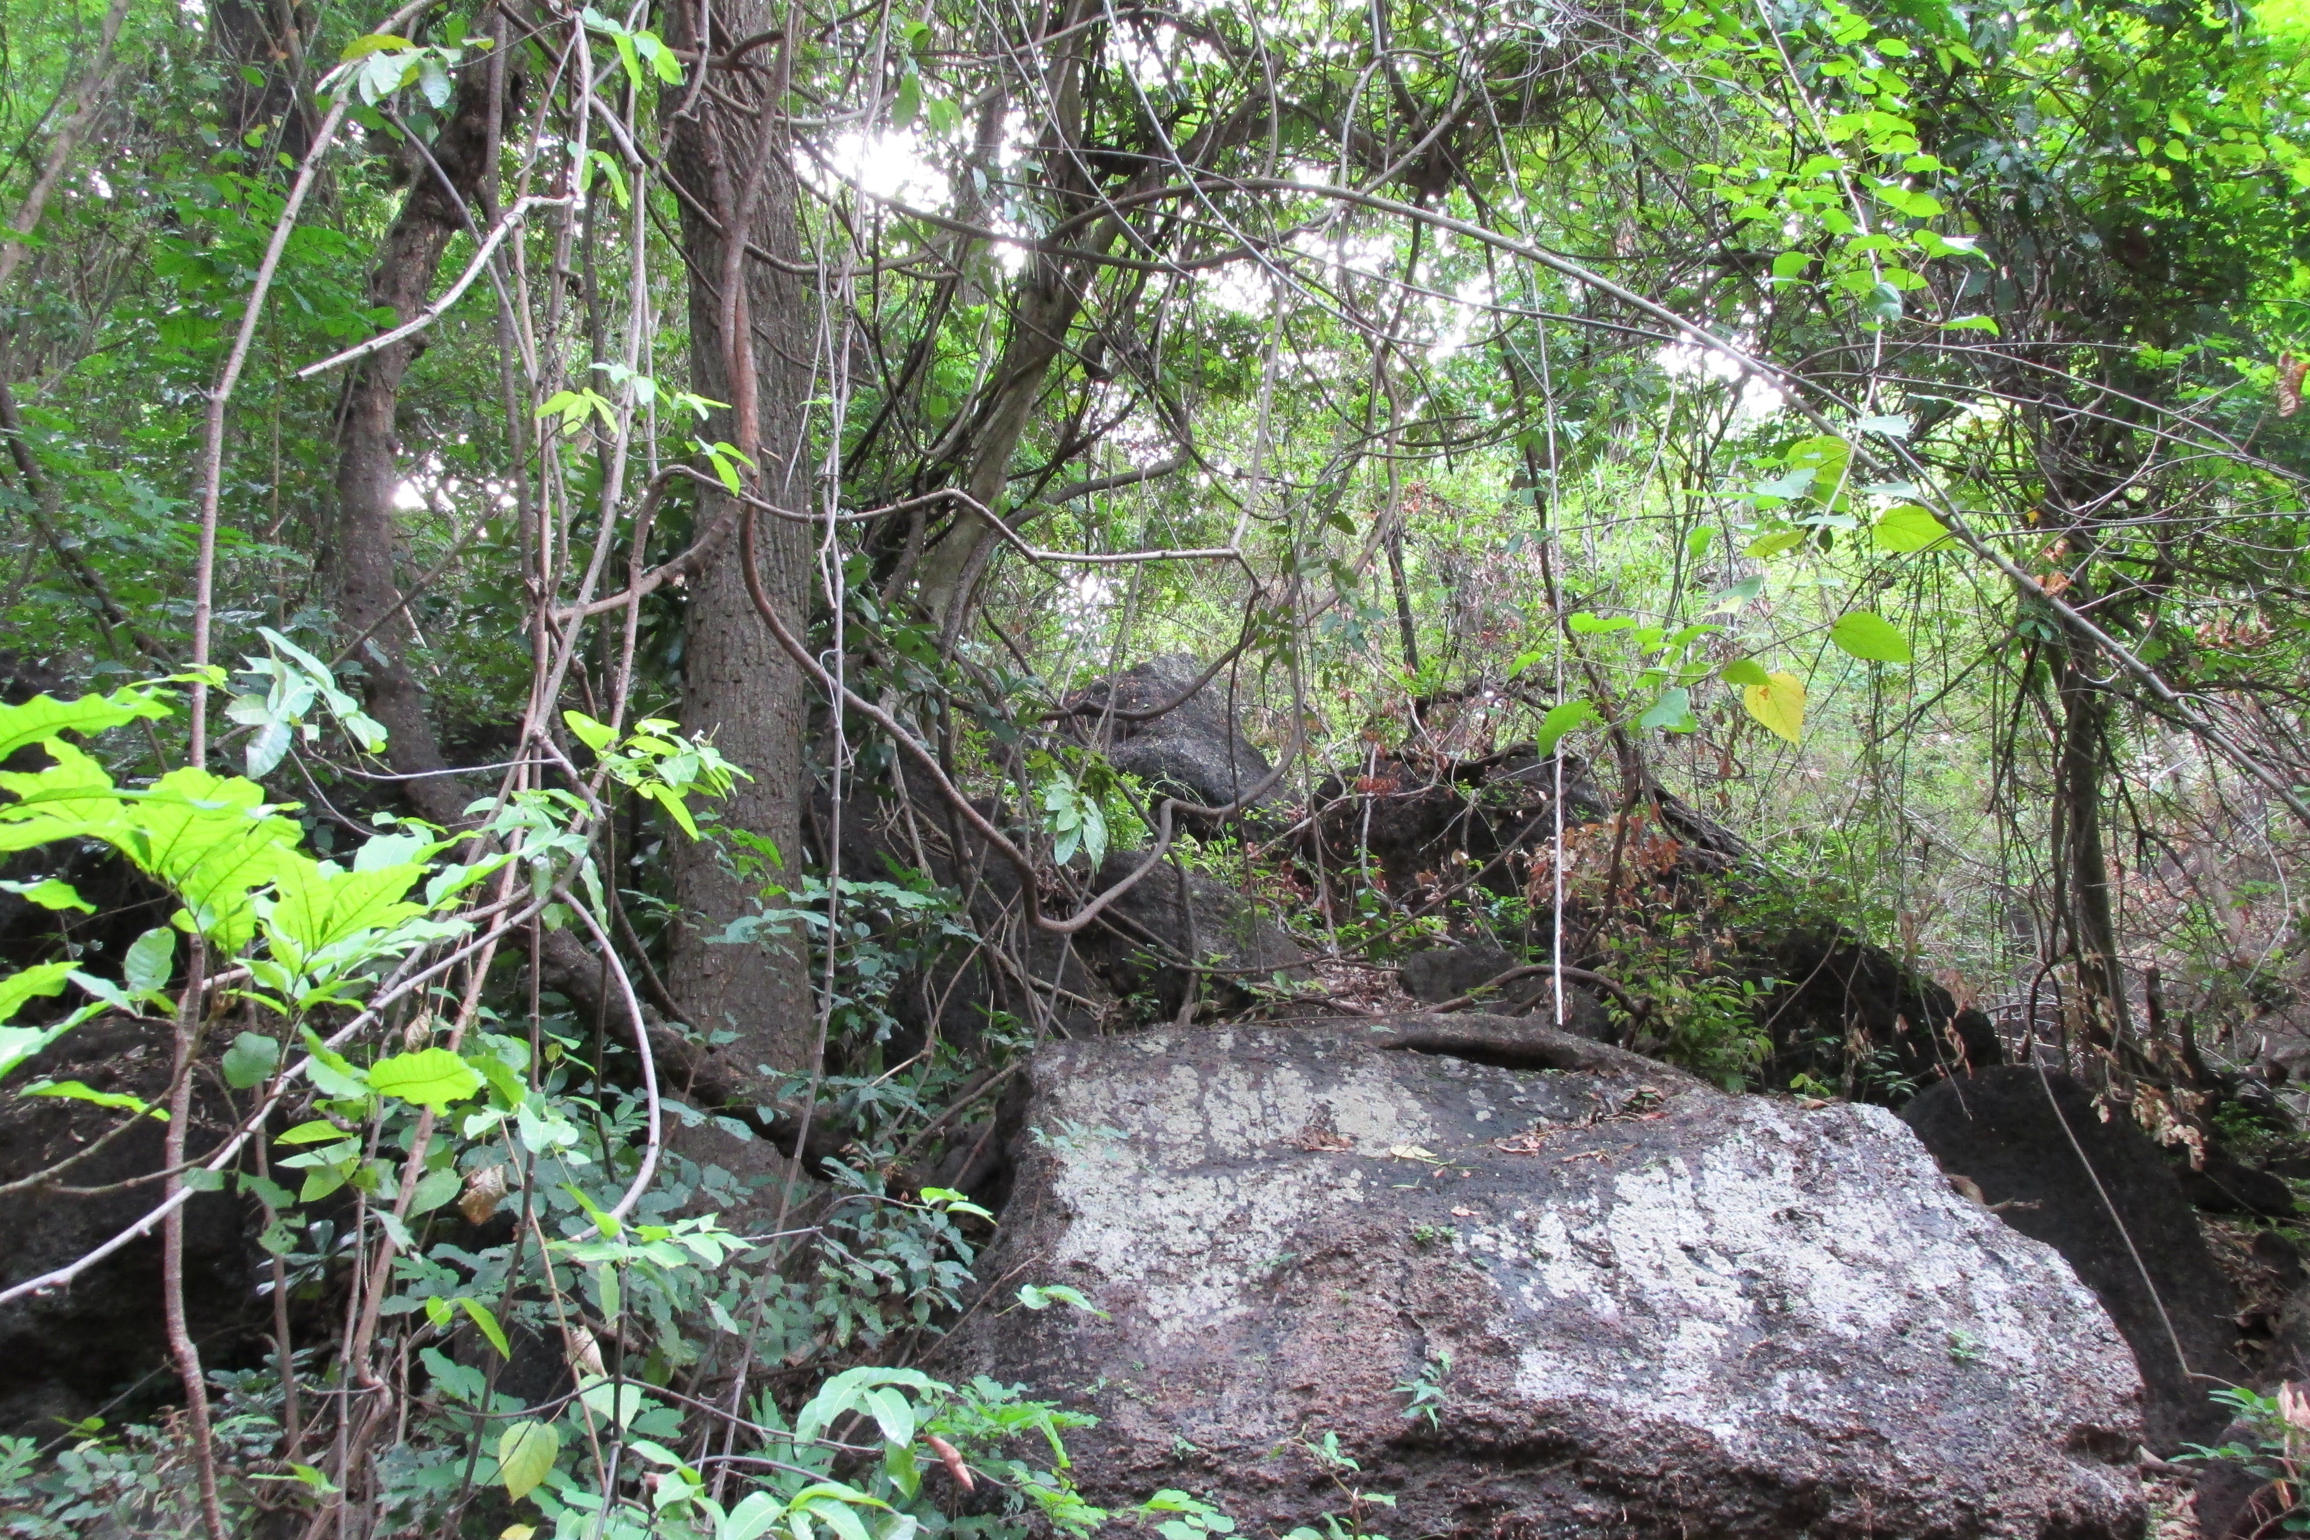
Photo credit: N.W.

Slide 8
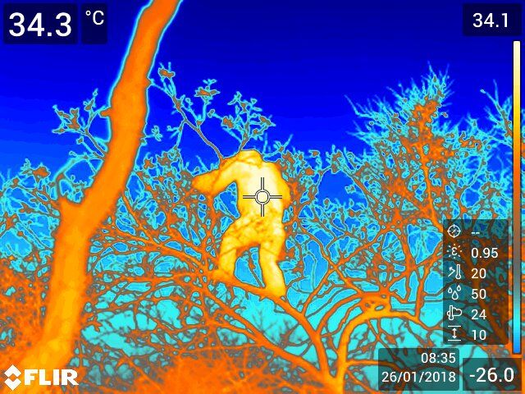
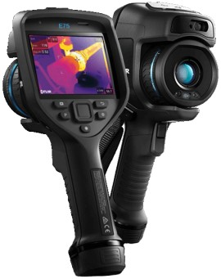
Notes:
So this is just an example of the kinds of images I’d capture
Collected over 800 thermo-images from the summer (810) & 169 of those are a form of bipedalism, which isn’t bad.
So I’d write data on positional behavior, habitat type, sun exposure, etc. and my goal was to see how this all impacted body temperature (this number in the corner)

Slide 9

Determining my best model…
Followed a Normal Distribution
Both Fixed and Random Effects present
LINEAR MIXED MODEL!
Made a full model reduced models compared AIC values
Compared best model with & without outliers
Residual plots
Notes:
Determined what type of model I’d need
Once getting my data in and doing some initial plots of my body temperature data, could see I had a relatively:
Normal distribution
Looking at my variables, I then figured out whether I had any random effects, or those that you’re not particularly interested in but that may still impact the model
Which I did – each male I collected data on may introduce some individual variation, so I wanted to include that as a random effect
This led me to a linear mixed effects model

Slide 10
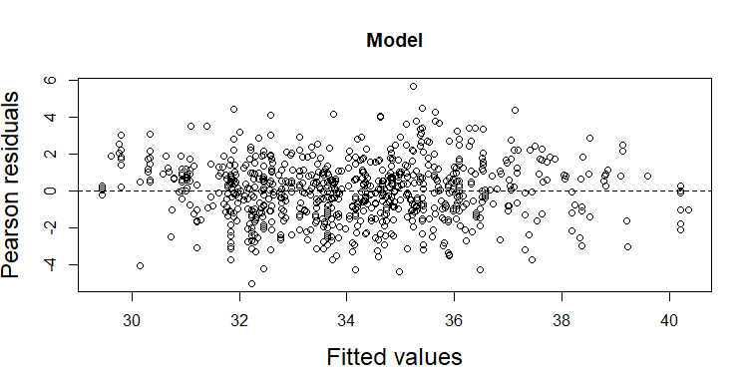
Notes:
The residual plots of my data without the outliers looked a little better than that with the outliers so I decided to go ahead with my model excluding thermo temps greater than or equal to 42C
Those are outrageously high and are more likely due to a camera error
So what did my final model look like?

Slide 11
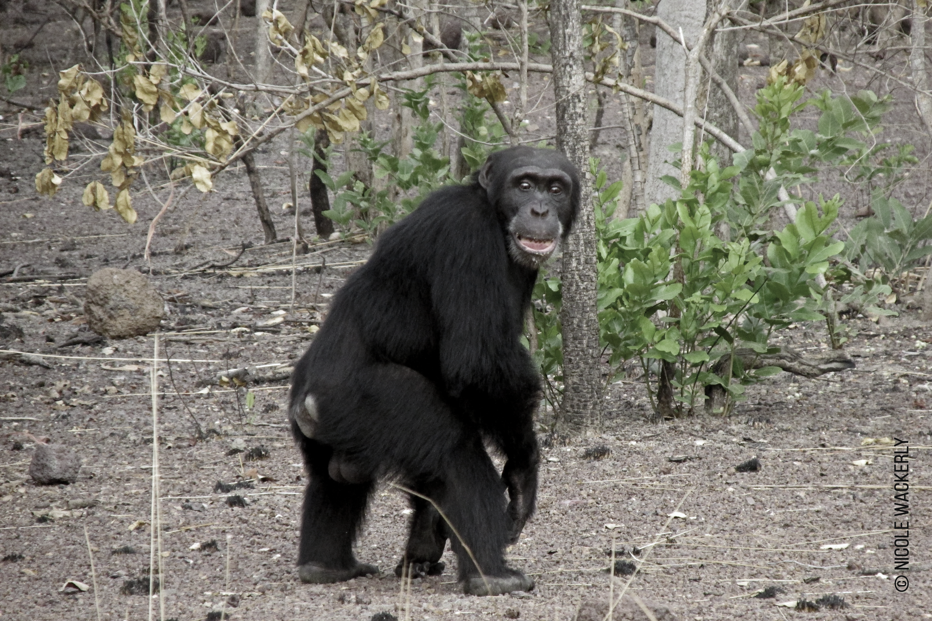
The model!
Linear Mixed Model
Thermo-temp ~ positional behavior + time of day + sun + date + habitat type + (1|individual)
Notes:
So the thermo-image temperature/body temp is my response variable
& I have 5 fixed effects (their positional beh, time of day (serving as temporary proxy for ambient temp), sun exposure, the date I collected those data, and their habitat type) and 1 random effect (the individual chimp on whom data were collected)

Slide 12
 | Estimate | Std. Error | t-value | Confidence Interval
Intercept | 988.83 | 117.51 | 8.415 | 759.12, 1215.38 *
Lie | -1.418 | 0.317 | -4.466 | -2.03, -0.79*
Squat | -0.310 | 0.679 | -0.456 | -1.63, 1.01
Sit | 0.143 | 0.256 | 0.559 | -0.64, 0.35
Quadrupedal Walk | -0.292 | 0.269 | -1.084 | -0.81, 0.23
Bipedal | -0.689 | 0.276 | -2.495 | -1.22, -0.15*
Suspensory | 0.084 | 0.571 | 0.148 | -1.19, 1.03
Vertical Climb/Cling | -0.641 | 0.407 | -1.576 | -1.43, 0.15
p-value
--
0.0002
0.9998
0.9993
0.9602
0.2001
1.0000
0.7657
Post hoc pairwise analysis with Tukey adjustment
- “results are averaged over the levels of: time_od & hab_type”
Notes:
So this is my model output. & I just included the positional behaviors for the purpose of this presentation, since they’re my main focus.
I used Quadrupedal Stand as the outgroup here, but often changed levels when assessing my model to compare between other positions
LMER models don’t provide a p-value, but to assess significance, I used both the given t-values (| | > 1.96) and calculated confidence intervals (don’t contain zero = significant) to see what was signif.
I added an asterisk to those deemed signif.
As you can see, only two positions are considered significant, but one of those is bipedalism; So I interpreted this as that the thermo temp will decrease by 0.689 when in the bipedal position when compared being in quadrupedal stand (the outgroup)
However, when doing the post hoc pairwise analysis with a tukey adjustment, I did not get a significant p-value for bipedalism vs. quadrupedal stand (0. 2001) or walk (0.4343), but did for bipedalism vs. sit (0.0356)?
- It said though that results are averaged over the levels of: time_od, hab_type, so idk if it excluded sun and date? Which are also important predictors? IDK if that makes a difference?
- P value adjustment: tukey method for comparing a family of 8 estimates
Still a bit confused by my intercept though…

Slide 13
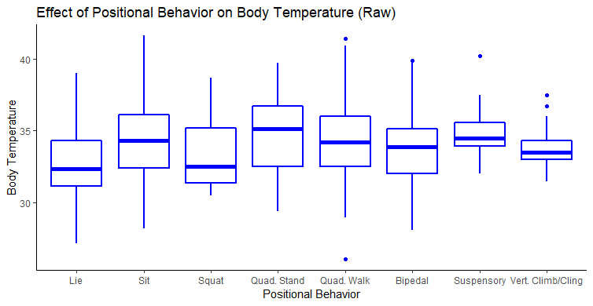
Notes:
We were struggling to plot my model results, and after making a messy plot showing my predicted data (red) against my observed data (black), we saw my predicted and observed weren’t thaaat different so I could just use my raw plot for now to show the data

Slide 14
Do different Positional behaviors vary in relative exposure to heat stress?
Postural and locomotor modes expected to differ in exposure to UV radiation, thereby altering the experienced thermal load
Bipedal posture and locomotion:
predicted to be associated with a lower body temperature
Notes:
I say this first one is slightly supported – not all positions differed significantly, but some were, such as lie and bipedalism
Even when changing the outgroup to check differences compared to other positions, certain positions, like lie and bipedalism, were always significant
I’d say the deeper part of my question, that goes back to early hypotheses on why humans became bipedal, may hold up?
When compared to quadrupedal stand, therm temp decreased by 0.689 when chimps were in a bipedal position & when compared to Sit, it decreased by 0.546
Which may not sound like a lot, but this is body temp we’re talking about, so it shouldn’t change too much in general?
However, with the post hoc pairwise test, which I’m still not totally sure about, it says this relationship is not significant so I’m not totally sure here…

Slide 15
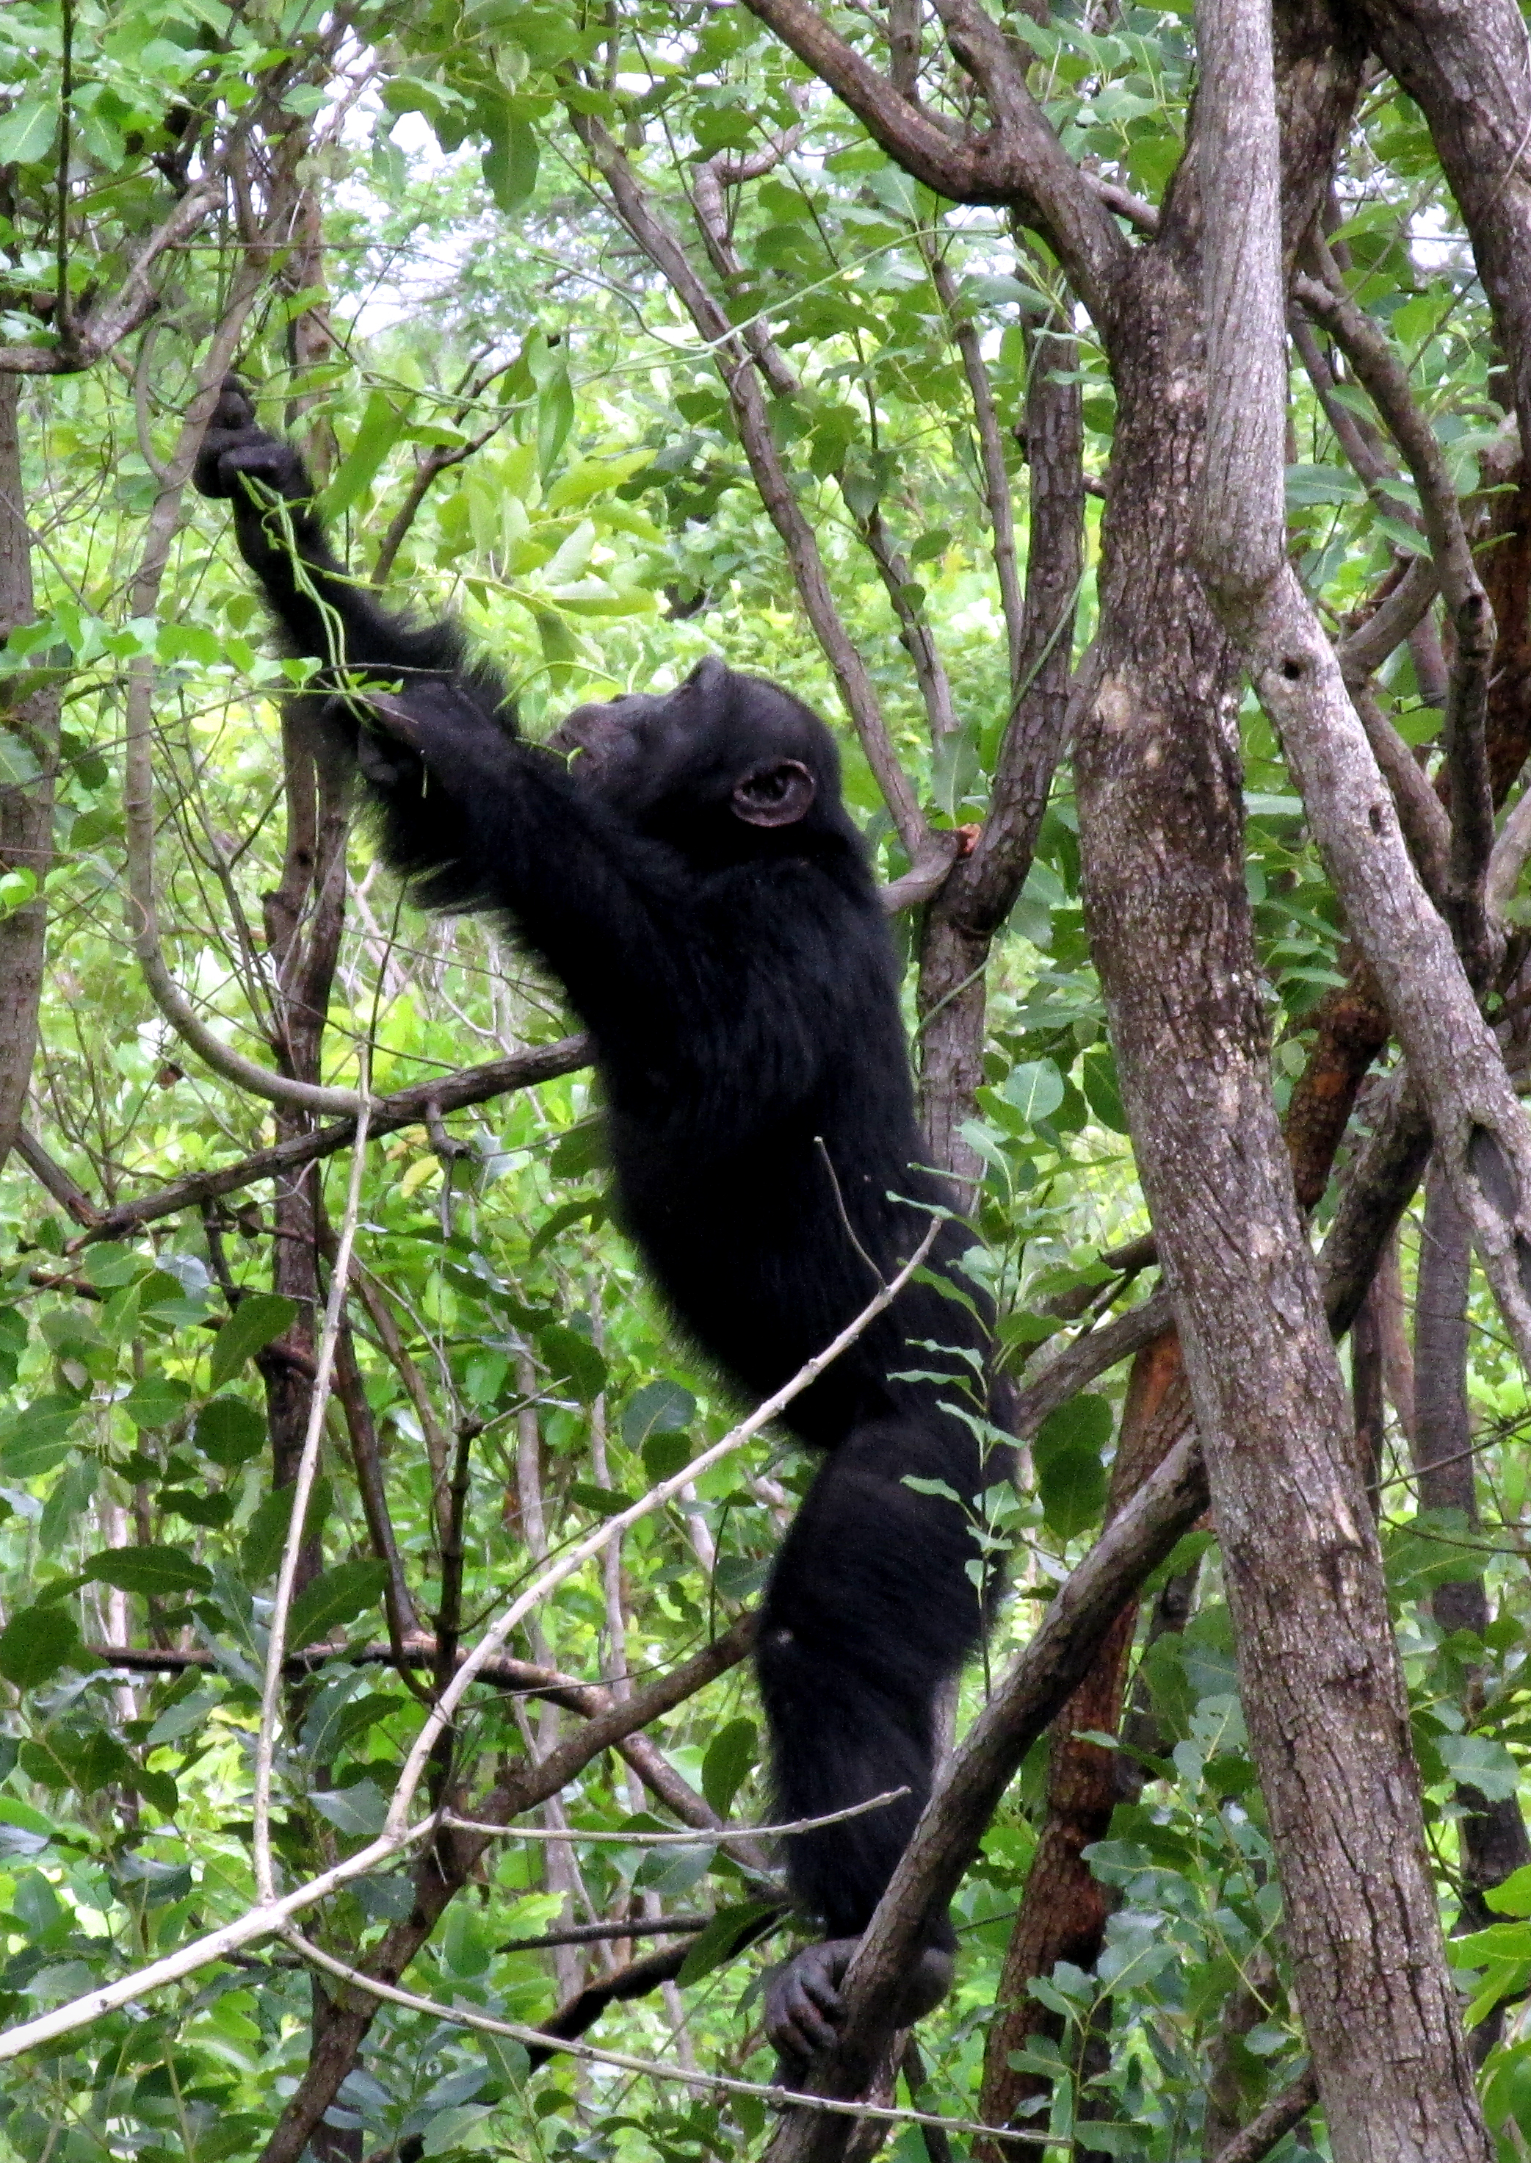
Conclusion
Only some positional behaviors differed significantly in their effect on body temperature when compared to other positions
Lie
Bipedalism…
Bipedalism as a means of thermoregulation?
Possibly…
© Nicole Wackerly
Notes:
It would help to have the ambient temperature data
& I think it would also help to have more habitat data, because as of now it’s mainly in woodland
It can be very difficult to get thermo-images in some of these other habitat types due to denser foliage and due to distance issues (can’t get close enough for the image!)

Slide 16
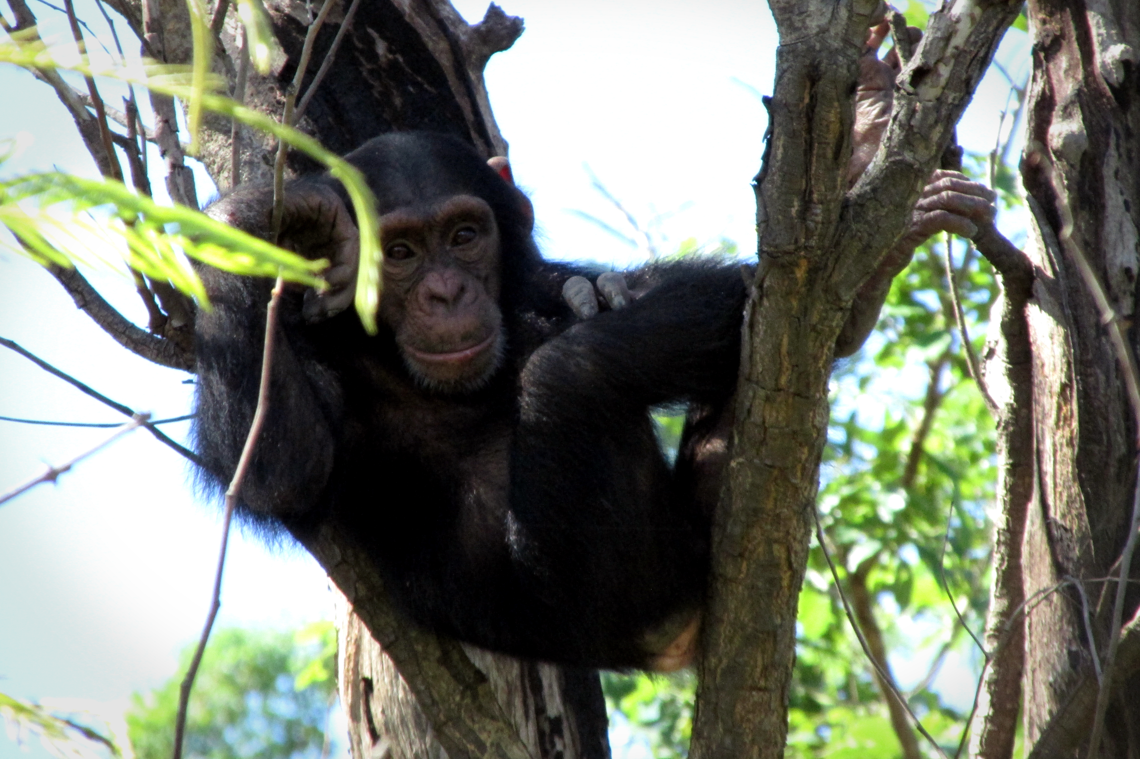
THANKS!!!
QUESTIONS??
© Nicole Wackerly

